Slide 1
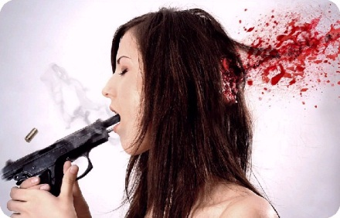
Suicide

Slide 2
Introduction
Suicide is an irrational desire to die. We use the term "irrational" here because no matter how bad a person's life is, suicide is a permanent solution to what is nearly always a temporary problem. Suicide is a symptom and sign of serious depression. Depression is a treatable disorder, but often the treatment takes time, energy and effort on the part of the person who's feeling depressed. Sometimes, as a person who is depressed feels the energizing effects of an antidepressant medication, they will still feel depressed, but have more energy. It is during this time in treatment that many people turn to suicide and suicidal acts.

Slide 3
People usually attempt suicide to block unbearable emotional pain, which is caused by a wide variety of problems. It is often a cry for help. A person attempting suicide is often so depressed that they are unable to see that they have other options: We can help prevent a tragedy by endeavoring to understand how they feel and helping them to look for better choices that they could make. Suicidal people often feel terribly isolated, because they distrust, they may not think of anyone they can turn to ...... which furthers the isolation.

Slide 4
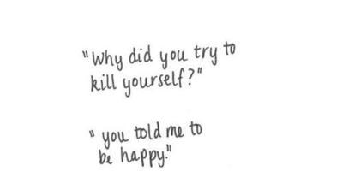
Ways To Prevent Suicide
Call a suicide hotline
A doctor
A school councilor (guidance teacher) or a normal teacher
A social worker
A priest or rabbi

Slide 5
Population .

Slide 6
Websites
The name of my websites where I got facts about suicide is: http://helpguide.org/ , http://kidshealth.org/ , http://www.psychologytoday.com/ , http://www.courierpress.com/ , and http://www.teens.webmd.com/ .

Slide 7
Tips for parents
Your child maybe suicide if: sadness, withdraw with family and friends , feeling lost of energy, sleeping difficulties, and lost in interest of activities.

Slide 8
Suicide is a 100% preventable , there are more ways than I just listed. Look up more reshearh and you will find you.
Tatiyna Brown 4th period.

